Slide 1


RUTGERS HEALTH HACK · SEVARO CHALLENGE 2 · TEAM 07
A human approves every call-in
No patient details in any message
Every action is recorded
Notes:
Hi, we're CoverGap. Sevaro's neurologists cover 200+ hospitals remotely. When one hospital surges just as doctors end their shift, a stroke patient can end up waiting with nobody approved there who is free. CoverGap minds that gap before it opens, and closes it with a person approving every step.

Slide 2

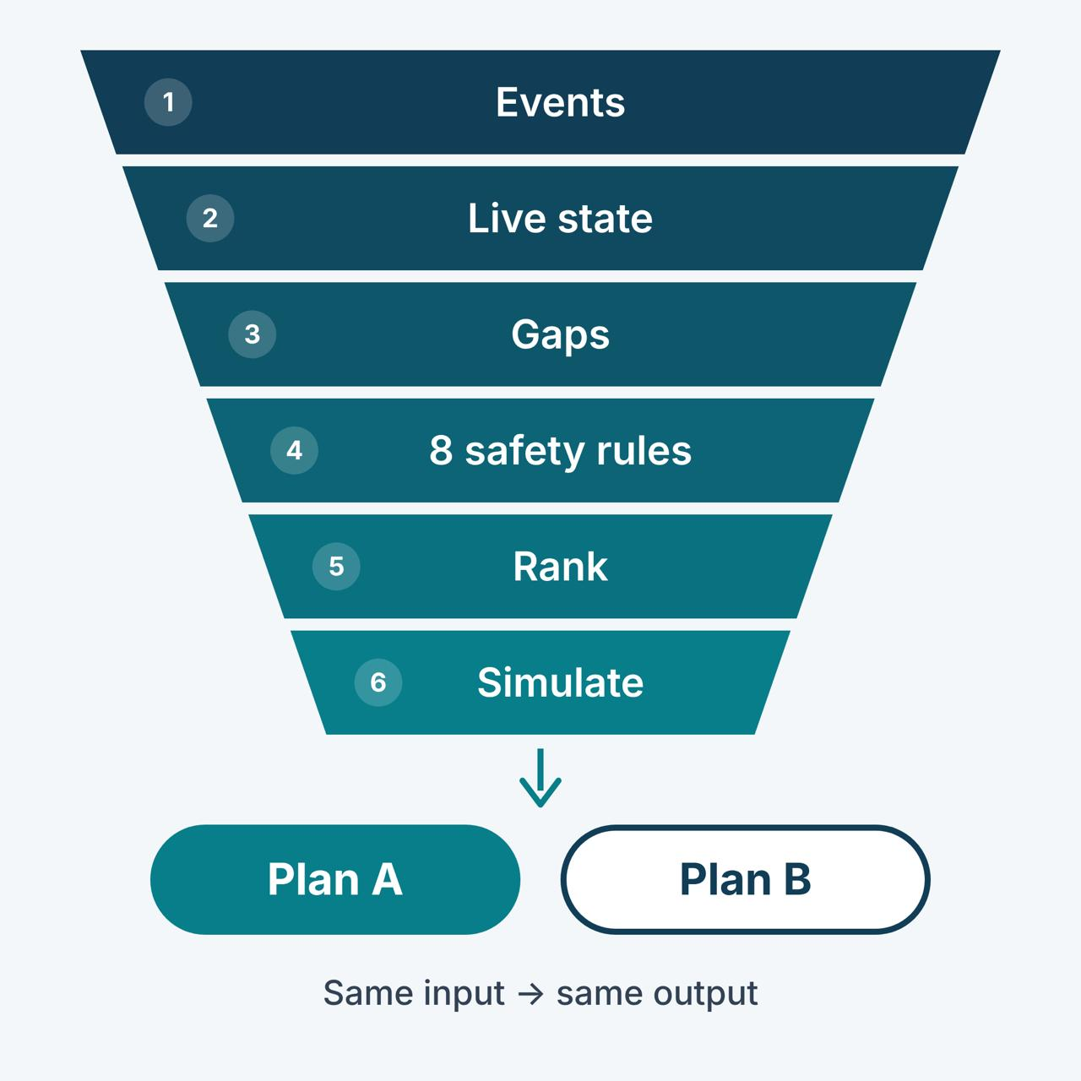
Minutes matter in a stroke. Coverage slips without warning.
THE PROBLEM · THE SOLUTION
The gap
A hospital suddenly sends a rush of stroke consults, just as doctors end their shift.
Doctors may be free but not approved at that hospital, so the patient waits.
Today someone has to notice, work out who can help by hand, and phone them.
How CoverGap closes it
Minds the gap: spots hospitals short of a doctor now or in the next 2 hours.
Picks the fix: the right off-duty doctor, with every safety rule checked.
Closes it: a clinical lead approves, the doctor accepts on their phone.
Notes:
The problem: Sevaro covers 200+ hospitals. A hospital can get a rush of stroke consults just as doctors finish their shift. Being free isn't enough, a doctor must be approved at that hospital, so a patient can wait while doctors sit idle elsewhere. Today a person has to spot it and fix it by phone. CoverGap watches for hospitals short of a doctor now or in the next two hours, picks the right off-duty doctor with every safety rule checked, and once the clinical lead approves, the doctor accepts on their phone.
For each problem, it checks every doctor against the brief’s 8 safety rules: opted in, credentialed at the hospital, 10h rest, at most 60h in 7 days, no clash with their own shift, at least 2h of useful time, one open offer, and fewer than 3 offers a week. It ranks the doctors who pass and offers the best fix as Plan A and the next best as Plan B, with the reason for each.

Slide 3






Six things no live screen does today.
WHAT MAKES IT UNIQUE
Role-shaped views
Options side by side
Reasoning for yes and no
Coordinator, clinical lead and doctor each see only what they need, ranked for them.
Each plan shows its effect on coverage and on the joining doctor's workload.
Every rule passed or failed, plus what happens if the plan is approved or rejected.
No swamped joiner
AI follow-up call
Trusts signals, not status
A routing simulator keeps the new doctor on the hospitals that need help.
No reply in a minute? An AI assistant calls and reads the approved offer.
Late, duplicate and conflicting records sorted out. Matches Sevaro's snapshot 146/146.
Note: For detailed version of the unique features, please refer to the product demo video
Notes:
What's unique. One: role-shaped views. The coordinator, the clinical lead and the off-duty doctor each see only what they need, ranked for them. Two: options side by side. Each plan shows what it does to coverage and to the joining doctor's workload, so the approver sees the trade-off. Three: reasoning for yes and no. For each off-duty doctor we show all eight safety rules, pass or fail, and every plan says what happens if it is approved and what happens if it is rejected. Four: a routing simulator stops a newly joined doctor from getting every call. Five: if the doctor doesn't reply within a minute, an AI assistant calls them and reads only the approved offer. Six: we rebuild the picture from what actually happened, not from what doctors self-report, and match Sevaro's reference snapshot on all 146 checks.

Slide 4
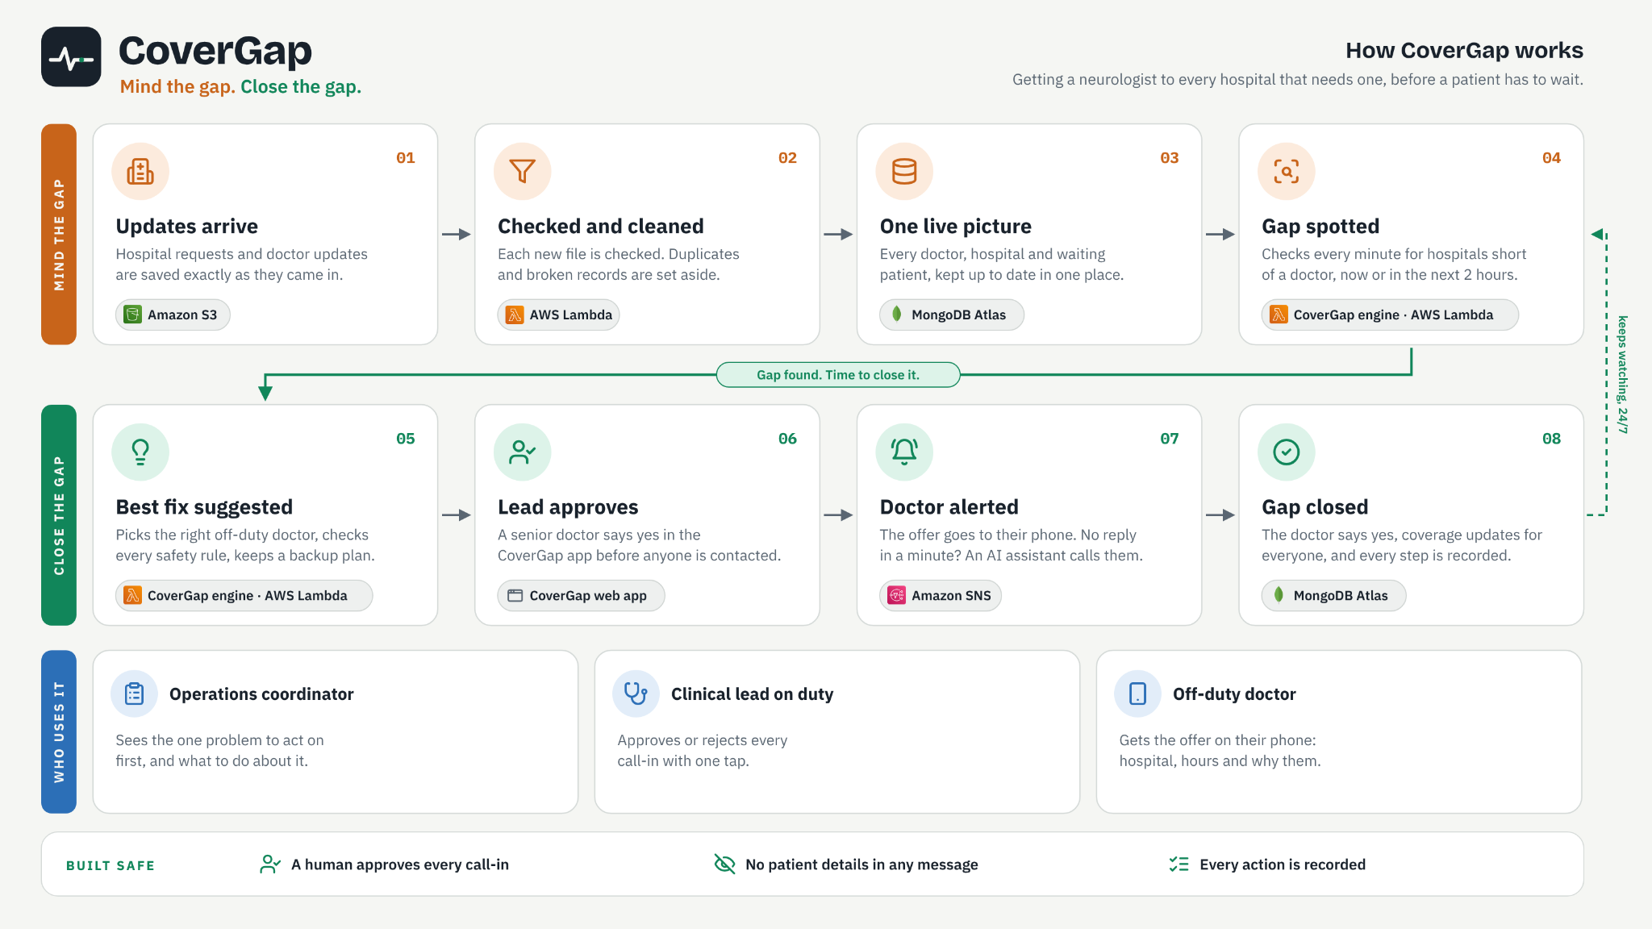
Notes:
Top row, mind the gap: updates arrive, get checked and cleaned, are replayed into one live picture, and the detection engine spots hospitals short now or in the next two hours. Bottom row, close the gap: the decision engine suggests the best fix, the clinical lead approves in the web app, the doctor is alerted on their phone with an AI follow-up call, and the gap closes with every step logged. Then it loops back and keeps watching. Today it runs on Python and FastAPI with a React and TypeScript front end, 38 automated tests, and no outside services needed. To run it in production at Sevaro's scale, our plan is Amazon S3 for incoming files, AWS Lambda for the engine, MongoDB Atlas for state and Amazon SNS for alerts.

Slide 5
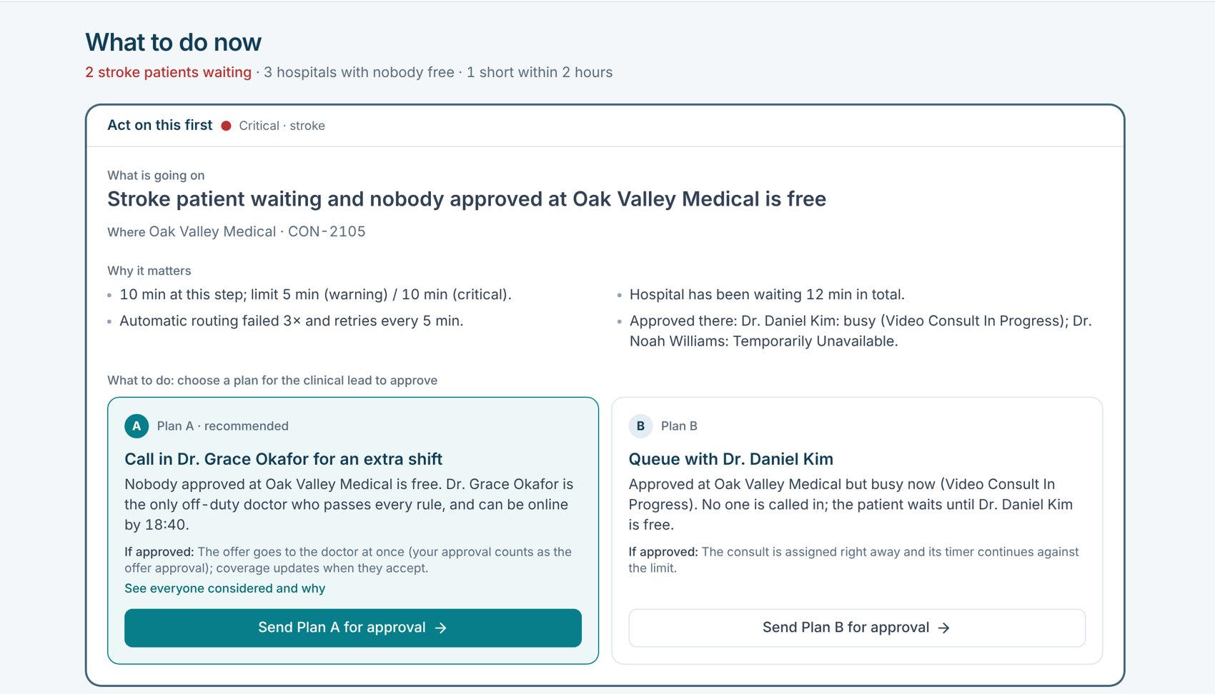
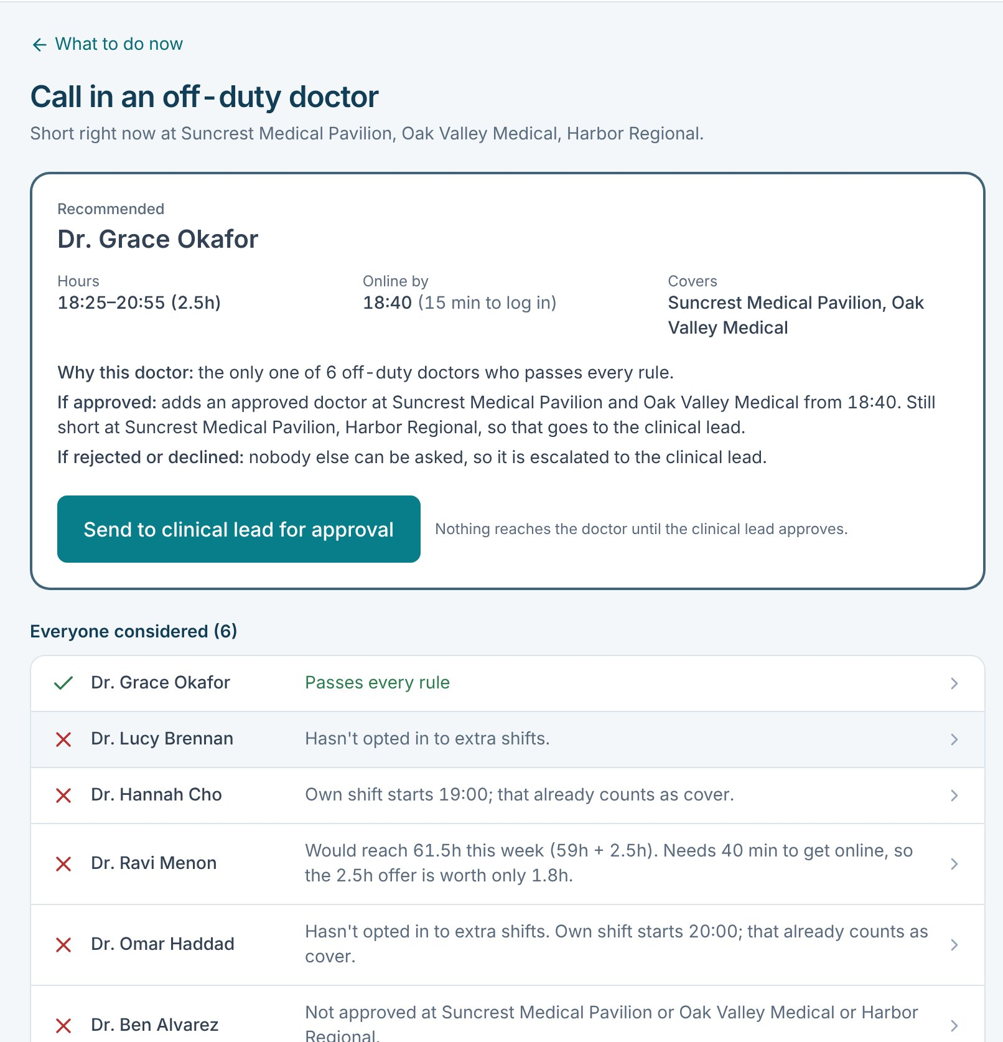
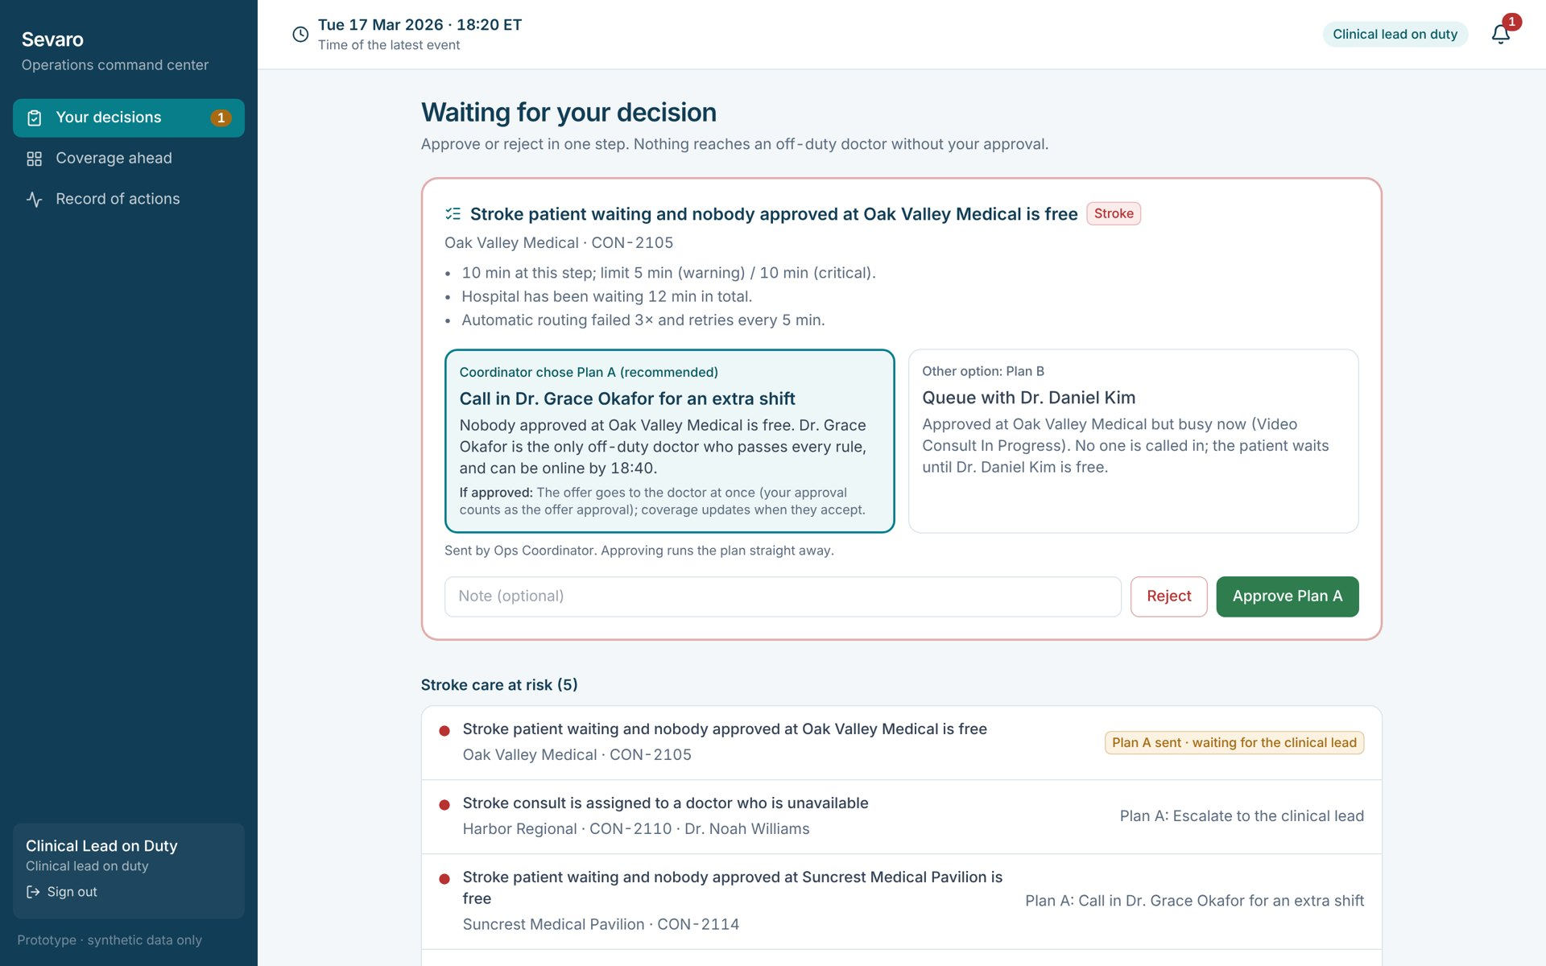
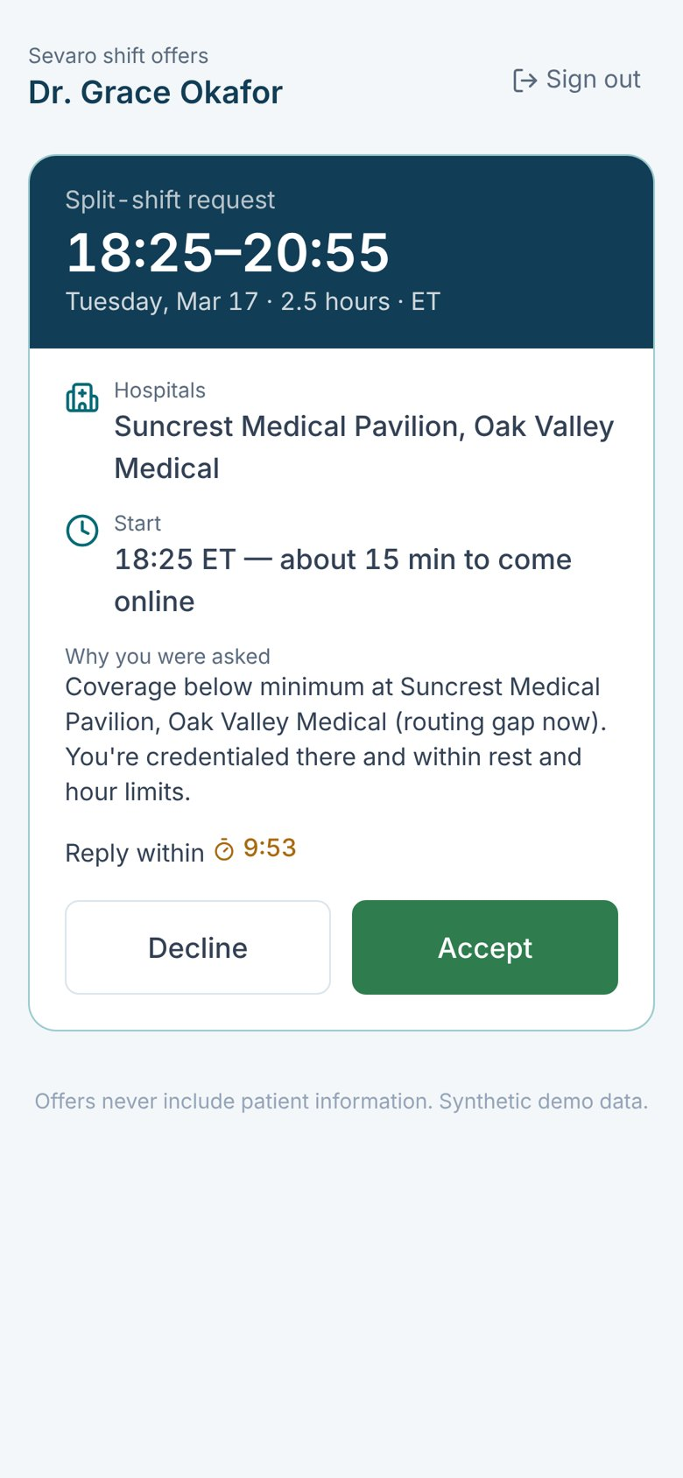
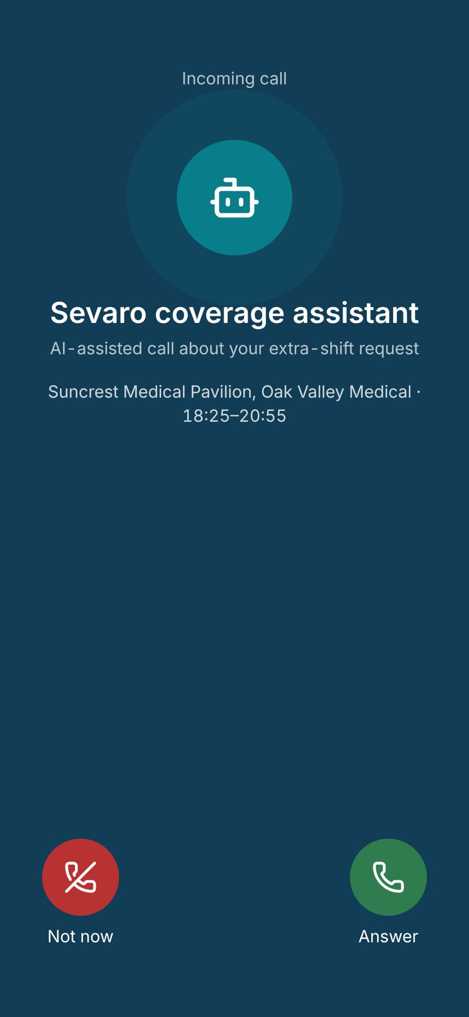
CoverGap in action
1 Coordinator: what to do now
2 Every rule, every doctor
3 Clinical lead approves
4 Doctor's phone: the offer · 5 AI follow-up call
From a gap spotted to a doctor saying yes: one clear screen for each person.
Notes:
These are live screens from our build. One: the coordinator's What to do now, with the top problem and Plan A and Plan B. Two: the decision screen showing every off-duty doctor and the rule each one passed or failed. Three: the clinical lead approving in one step. Four: the offer on the doctor's phone, with no patient details and a ten-minute countdown. Five: the AI follow-up call if they don't reply within a minute.

